Slide 1
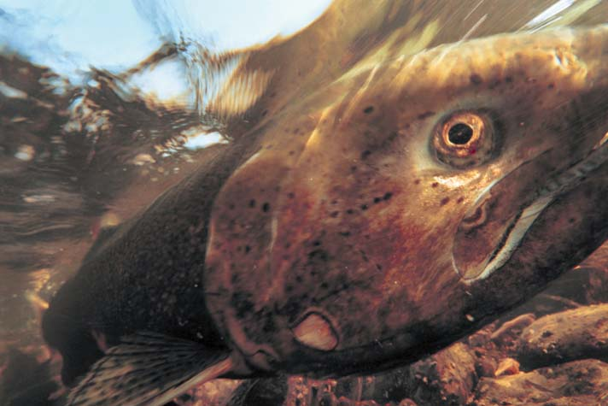

Piped Downstream Fish Bypass at Cougar Dam in the Upper McKenzie Basin
Jeff Ziller
District Fish Biologist
South Willamette Watershed
Oregon Department of Fish and Wildlife
Informational slides provided by Portland General Electric and the US Army Corps of Engineers

Slide 2
Background: timeline
WVP ESA Section 7 Consultation
Cougar Dam Completed
Storms raise elevation to 1413¹
(high turbidity event)
Cougar Downstream Passage
Engineering Design Report
Drawdown to 1450’
(avoids sediment transport impacts)
Cougar Temperature Control Tower EIS
Drawdown to 1375’
‘63
‘95
Temperature Control Tower Construction
UWR salmonids ESA listing
Willamette Valley Project (WVP) BA
NMFS WVP BiOp
‘00
‘01
‘02
‘03
‘04
‘05
‘06
‘07
‘08
‘99
Cougar Tower EA Amendment²
Cougar Adult Fish Facility EA
Cougar Adult Fish Facility Construction
Drawdown to 1450’ for emergency trash rack repairs
WVP COP Phase I
analysis²
WVP COP Phase II
analysis³
Cougar
Downstream Passage Construction
WE ARE HERE
Cougar
Downstream Passage
Detailed Design Report
‘09
‘10
‘11
‘12
‘13
‘14
‘15
‘16
‘17
Plans & Specification
NEPA Analysis
EA released for Public Review
‘17
‘18
‘19
‘20
‘21
‘22
‘23
Notes:
¹ During the first year of the Cougar Water Temperature Control Tower construction, the Cougar Reservoir drawdown coupled with two large storms and a slope failure on Rush Creek upstream of the dam resulted in unexpected high turbidity below the dam between December 31, 2002 and February 3, 2003. A supplemental information report and EA was completed to investigate whether the turbidity had caused significant impacts to the river environment and alternative methods of operating Cougar Reservoir during the remaining 2 years of construction to address any identified impacts. It was determined that maintaining the reservoir at 1450’ prevented identified sediment transport and turbidity impacts. Managing the reservoir at elevation 1,450 during the remainder of construction kept turbidity in the mainstem McKenzie within successful fishable limits and, although the river was high, good insect hatches were reported.
² In 2009, the Portland District completed the Reconnaissance Phase (Phase I) of the COP as described in the 2008 BiOp RPA (measure 4.13). The Phase I COP Report identified a range of structural and operational measures to be considered, established preliminary system-wide priorities, and outlined a process to formulate and evaluate alternatives during the COP Phase II effort.
³ Using the latest biological study results and analysis of feasibility, this Phase II report provides determinations regarding the feasibility of fish passage, water temperature control, and other related structural, operational, or habitat improvement alternatives. It provides specific recommendations for improving biological conditions for ESA-listed anadromous fish species in the Willamette system, includes recommendations for major structural and operational changes, and considers the potential effects of implementing proposed alternative(s) on ESA-listed resident fish (bull trout and Oregon chub). The process used to evaluate subbasin alternatives and system-wide scenarios for biological benefit, technical feasibility and cost-effectiveness was completed in several steps

Slide 3
Alternatives Analysis History
Engineering Design Report – Alternatives Analysis (will be described in Environmental Assessment)
Six structural alternatives for downstream passage at Cougar Dam were prioritized:
• Alternative No. 24: Weir Box/Collection Channel with holding barge and truck transport
• Alternative No. 25: Weir Box/Collection Channel with tower bypass
• Alternative No. 28: Floating Screen Structure with holding barge and truck transport
• Alternative No. 29: Floating Screen Structure with tower bypass
• Alternative No. 5: Floating Surface Collector with tower bypass
• Alternative No. 20: Floating Surface with holding barge and truck transport
Notes:
During the earlier PDT, three of the six alternatives included bypass through the tower.

Slide 4
Alternatives Analysis History
Quantitative Analysis based on COP Phase II Screening Criteria:
Meet dam safety requirements
Maintain flood risk management
Above-dam fish reintroduction efforts must reach “replacement”
Cost-effective, including consideration of hydropower impacts – considered but not a deciding factor.
Non-monetized impacts were also Scored (high negative impact (1) up to a high benefit (5)):
Flood risk management
Meeting Downstream Tributary Flows
Meeting Mainstem Flows
Reservoir Recreation
River Recreation
Initial Array of 30 alternatives developed
Prioritization and Screening
Top 11 Alternatives: 6 Structural, 5 Operational
further developed
EDR preliminary design & screening
Preliminary Preferred Alternative:
Floating Screen Structure w/ Truck and Haul
Water Supply- M&I and Irrigation (Future and Current)
Constructability
Implementation Timing
Clean Water Act (TDG)
Temperature
Notes:
Through an internal USACE process, the preliminary preferred alternative was: Floating Screen Structure with trap and haul.

Slide 5
Alternatives Analysis History
Quantitative Analysis based on COP Phase II Screening Criteria:
Meet dam safety requirements
Maintain flood risk management
Above-dam fish reintroduction efforts must reach “replacement”
Cost-effective, including consideration of hydropower impacts – considered but not a deciding factor.
Non-monetized impacts were also Scored (high negative impact (1) up to a high benefit (5)):
Flood risk management
Meeting Downstream Tributary Flows
Meeting Mainstem Flows
Reservoir Recreation
River Recreation
Initial Array of 30 alternatives developed
Prioritization and Screening
Top 11 Alternatives: 6 Structural, 5 Operational
further developed
EDR preliminary design & screening
Preliminary Preferred Alternative:
Floating Screen Structure w/ Truck and Haul
Water Supply- M&I and Irrigation (Future and Current)
Constructability
Implementation Timing
Clean Water Act (TDG)
Temperature
Notes:
For many reasons the Floating Screen Structure with trap and haul was thought to be the best alternative although there was no clear evidence that this type of facility would provide “replacement” of fish used for re-introduction above Cougar Dam.

Slide 6
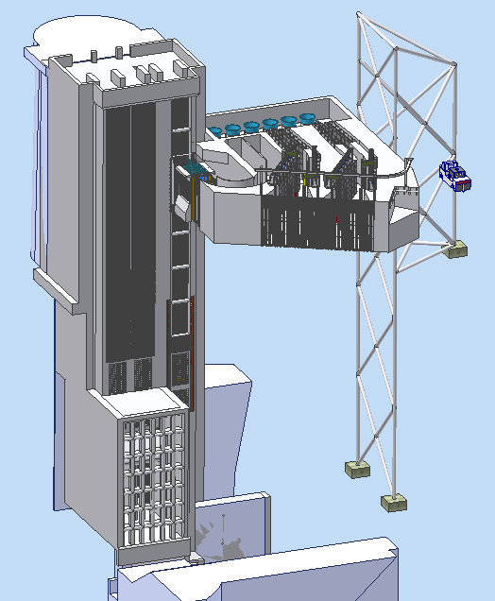
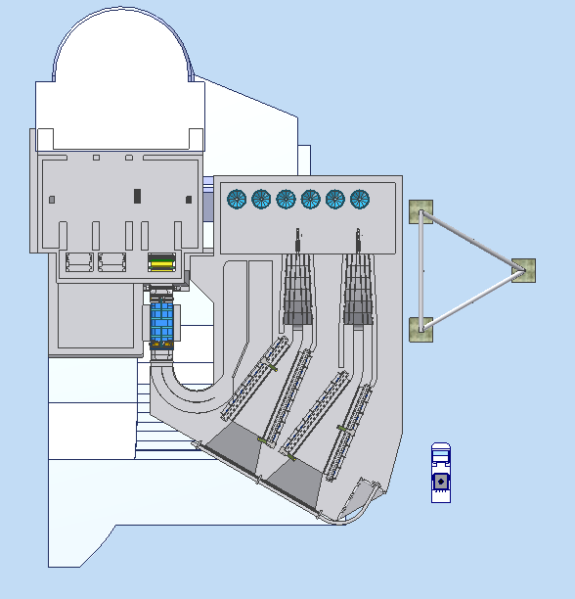
Location – Near Water Temperature Control tower
WTCT
FSS
MOORING
TOWER
MOORING
TOWER
WTCT
AMPHIBIOUS
VEHICLE
400 cfs
600 cfs
FSS
AMPHIBIOUS
VEHICLE
Notes:
The current design for downstream passage at Cougar Dam includes two screened collection entrances (400 and 600 cfs), a series of tanks for holding fish, and an amphibious vehicle for transportation.

Slide 7
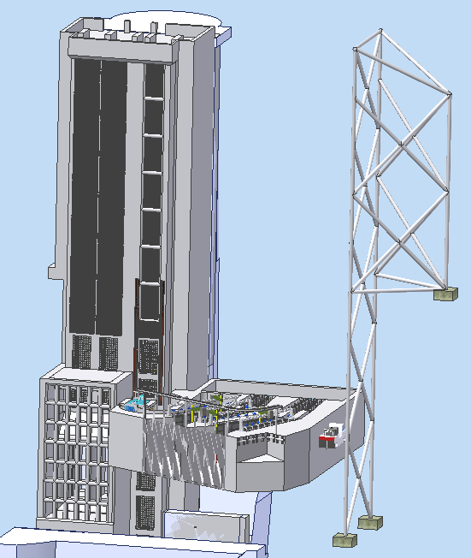
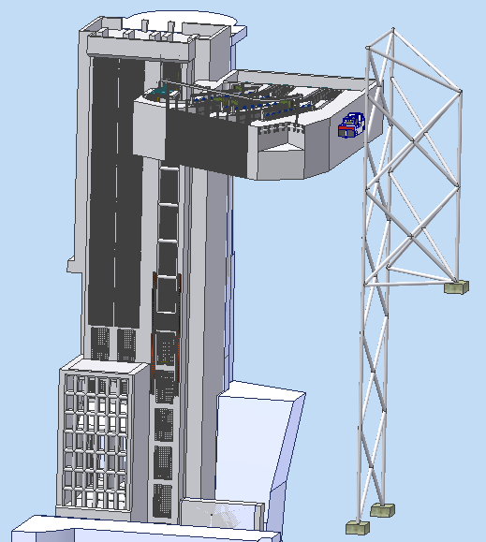
Pool Fluctuations
Elevation ~1,690
158 Ft.
Elevation ~1,532
Notes:
The current design for downstream passage at Cougar Dam proposes to operate over a range of 158 feet from an elevation of 1532 feet to 1690 feet.

Slide 8
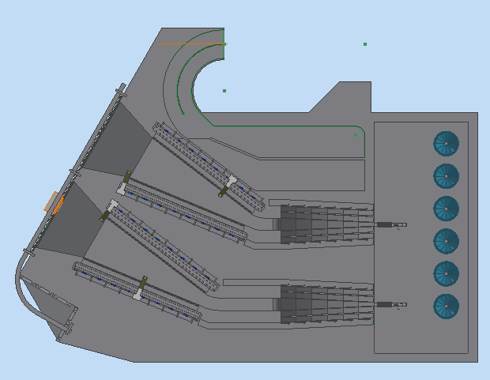
Fish Movement Through System
CAPTURE VELOCITY
~8 FT/S TAKES PLACE
AT THE SECONDARY SCREENS.
AV W/ TRANSPORT TANK
Notes:
Fish are to be diverted into fish separator (by size) and into holding tanks prior to loading into the transportation vehicle.

Slide 9
A change in direction?
The original decision to proceed with a trap and haul facility was made about two years ago.
Since then some new information has emerged on fish passage successes and disease issues.
A combination of our long time interest in allowing fish to leave the reservoir on their own volition and new information has lead us to consider modifications to the current Cougar Fish passage design.

Slide 10
New Information – Clackamas River
North Fork and River Mill dams piped bypass collection systems appear to be functioning well
97%+ collection efficiency
99% survival
Limited success for trap and haul systems around the Pacific NW (Kock, USGS)

Slide 11
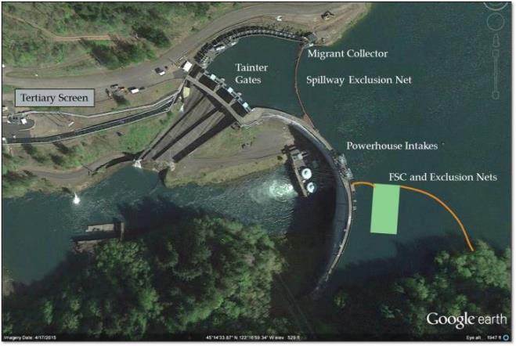
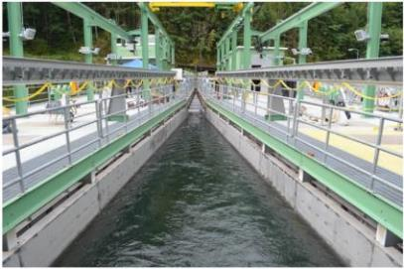
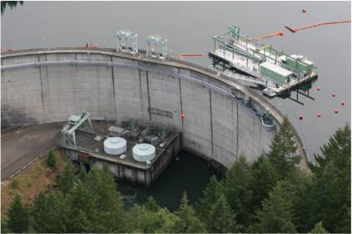
North Fork Floating Surface Collector
Characteristics:
Built: 2015
1000 cfs pumped flow
No on board sampling
Design/build = 42 million
Notes:
In the interest of time I’m not going spend a lot of time in project description. However Portland General Electric operates a three dam hydro-complex 123-MW complex in the Clackamas River. The average discharge for the Clackamas River is 2750 cfs. We have three native species of anadromous salmonids, winter steelhead, spring Chinook and coho. Pacific lamprey are also present and actively recolonizing habitat upstream of the project.

Slide 12
Big Picture-All species run year outmigrant count
Notes:
You’ll notice that I didn’t talk about coho and that’s because out of the three species the impact of the improved infrastructure on recruits per spawner, length frequency of outmigrants collected, and juvenile life histories collected remained fairly constant from pre versus post infrastructure improvement. However for my pièce de ré·sis·tance I added them in to provide context to the total number of outmigrants handled in a RY by the bypass systems.

Slide 13
Clackamas relative to McKenzie CHS
Notes:
This is a plot of the performance of the Clackamas and McKenzie in each run year relative to their 2003-2014 mean. I chose to compare the Clackamas to the McKenzie as both systems are the last two strongholds of wild spring Chinook in the Willamette basin and the two populations are presumably effected by common environmental conditions during the freshwater and ocean phases of their life due to their regional proximity and similar genetics. in an attempt to detect increased performance commensurate with fish that outmigrated through the new infrastructure.
The reason I chose that date range is 2003 was first year all returning hatchery Chinook were marked with a fin clip and 2015 represents the first run year were 4 year old Chinook that would have passed downstream from the new infrastructure. While it is only two run years, the divergence between the Clackamas and the McKenzie is apparent
2016 wild Chinook run 166% of average while the McKenzie wild run was 83% of average for a Delta of 83%. The 2016 run year represented the largest positive delta between the two systems in the 12 years of data examined. The second largest delta between the two systems is 59% in 2015.
2015 was 117% while the McKenzie was 78%

Slide 14
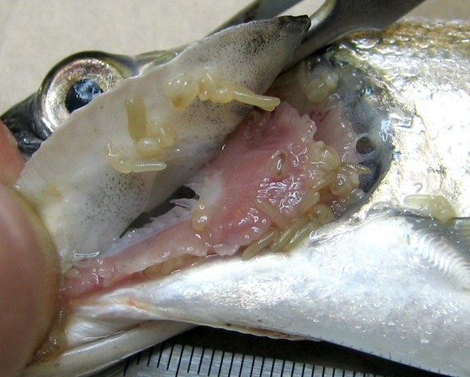
New Information - Copepods
Copepod infestations of Chinook in USACE reservoirs appear to exacerbate handling mortality
USACE funded reservoir research provided 7 years of copepod information
Notes:
It is becoming quite apparent to biologists working in the Willamette Basin, that copepod infestations can exacerbate handling and holding mortality on juvenile salmon. Experimental data is lacking however anecdotal information is very compelling.

Slide 15
Piped Bypass Alternative
Connection point
Directional Bore at Elevation less than 1532
Flexible pipe
Elevation 1532
Notes:
A method of emulating the piped bypass system at Clackamas for Cougar Dam. Flexible hose would allow fish and water to gravity feed through a pipe that would be placed in a directionally bored hole through the rock on the left side of the dam. The connection point would have a quick disconnect and a gate. On the downstream side of the pipe, fish would descend in a non-pressurized pipe and would be exited to the South Fork McKenzie without delay. A sub-sampling device could be installed at the bottom end of the pipe to determine fish survival and relative numbers.

Slide 16
Fish Movement Through System
CAPTURE VELOCITY
~8 FT/S TAKES PLACE
AT THE SECONDARY SCREENS.
AV W/ TRANSPORT TANK
Notes:
Fish would go directly into the bypass pipe. No handing or holding tank delays.

Slide 17
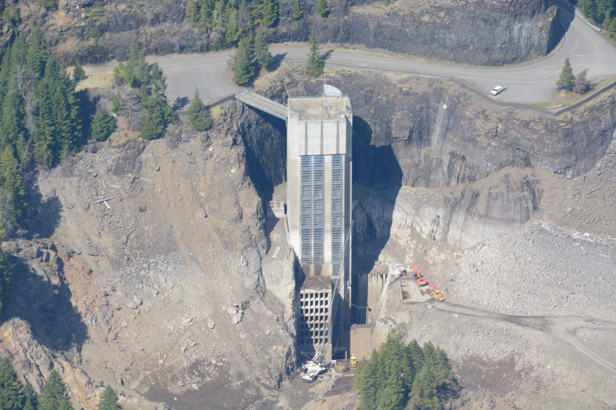
Directional Bore at Elevation less than 1532
Connection point
Flexible pipe
Elevation 1532
Notes:
Overview of what it might look like…

Slide 18
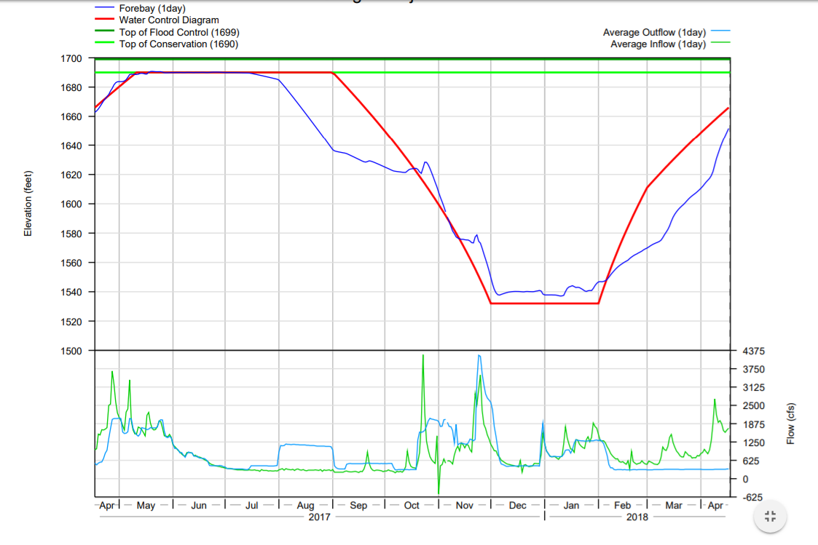
Fish passage “Rule Curve”
Notes:
The basic idea is to have the reservoir down at elevation 1532 during the bulk of the Chinook and bull trout outmigration, allowing them to pass the dam on their own volition without delay or handling.
This allows piped bypass for a limited range of reservoir elevations during the peak of the outmigration season, reducing design complexity/challenges.
The collection facility will quickly disengage from the bypass pipe to allow the reservoir to capture flows as necessary to maintain flood control capability.
Once the reservoir is back up and the bypass pipe is disconnected, a smaller trap and haul effort can continue with fewer fish anticipated to be migrating outside of peak season, requiring smaller holding capacity.

Slide 19
Catch of juvenile spring Chinook in the Cougar Reservoir Floating Fish Collector 2014-16
“Rule Curve”
Notes:
Holding the reservoir down at 1532 and attaching the floating fish collector to the passage pipe would allow volitional passage for the vast majority of the juvenile Chinook over 60 mm. Some fry could also be volitionally passed during February and March. As the reservoir fills, the FFC would be placed into trap and haul mode to capture the fry migration.

Slide 20
Fish benefits of piped bypass at Cougar Dam
Excellent chance of meeting fish passage criteria
Lower handling stress
Real-time passage timing
Lower risk of extinction of wild Chinook population

Slide 21
Construction benefits of piped bypass at Cougar Dam
Smaller footprint could lower cost
Much smaller holding tanks
Smaller fish separation facilities
Potential for reduced rock removal

Slide 22
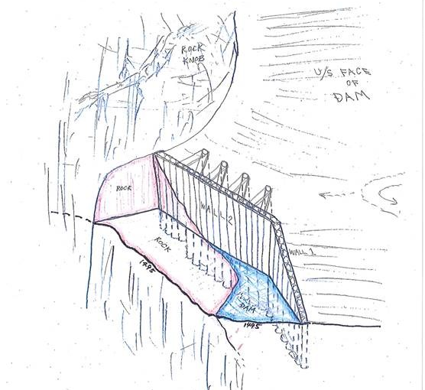
Construction features during drawdown
Retaining wall
Rock excavation
Mooring structures
Tower modifications
Notes:
With potential smaller FSS footprint (smaller tanks) associated with piped bypass design, could require less rock excavation and other less aggressive construction elements.

Slide 23
Construction benefits of piped bypass at Cougar Dam
Smaller footprint could lower cost
Much smaller holding tanks
Smaller fish separation facilities
Potential for reduced rock removal
Constructing the best possible passage now eliminates necessity to gain political will for reconstruction of a failed effort
Notes:
Increases likelihood of project success in successfully passing Chinook and bull trout downstream and avoids the risk of having to request additional funds for post-construction modifications.

Slide 24
Operational benefits of piped bypass at Cougar Dam
Much lower staffing than trap and haul facility
No need for 24 hr crews
Potentially one person operation like North Fork Reservoir
Huge annual cost savings
Simplified winter operations
Simplified monitoring accomplished by subsampling at the end of the pipe
Potential for auxiliary water supply for Cougar Upstream Migrant Facility

Slide 25
Schedule
Initial Drawdown of Reservoir to 1450’– 1 month
Drawdown maintained at 1450’ - 1 Year (~2021)
Temperature Control Tower Modifications for connecting Floating Screen Structure
Mooring construction
Rock removal for Floating Screen Structure (FSS)
Retention wall construction
Flow likely below minimum flow requirements (coordinating with NMFS)
Staging/Construction at Slide Creek Campground - 2 years (~2021-2022)
Coffer dam off portion of near shore to construct FSS. Once complete, FSS will be floated downstream to Temperature Control Tower.
Will require large areas for large machinery and stockpiles
WE ARE HERE
Construction Alternatives Analysis
Develop design, confirm constructability
Environmental Impacts Assessment – NEPA
public review and comment – Fall/Winter 2018
Refine/optimize the recommended solution
Detailed Cost Estimate
Complete
Determine problem
Determine solutions that would solve the problem
Initial Alternatives Analysis and Screening
Cougar
Downstream Passage Construction
Cougar Downstream Passage
Engineering Design Report
Cougar
Downstream Passage
Detailed Design Report
Plans & Specification
NEPA Analysis
‘15
‘16
‘17
‘18
‘19
25
‘20
‘21
‘22
‘23
Notes:
Incorporating piped bypass could be accomplished without delaying the current schedule, however, it would take additional up-front effort to design the pipes and bypass portions of the facility.

Slide 26
What we would like to see:
A dedicated effort to design piped bypass through Cougar Dam
Current effort does not appear large enough to provide feasible alternatives
Highly reduced handling of fish
Real time passage (no holding time)
Notes:
Piped bypass must be incorporated into the current design for the best chance of success.

Slide 27
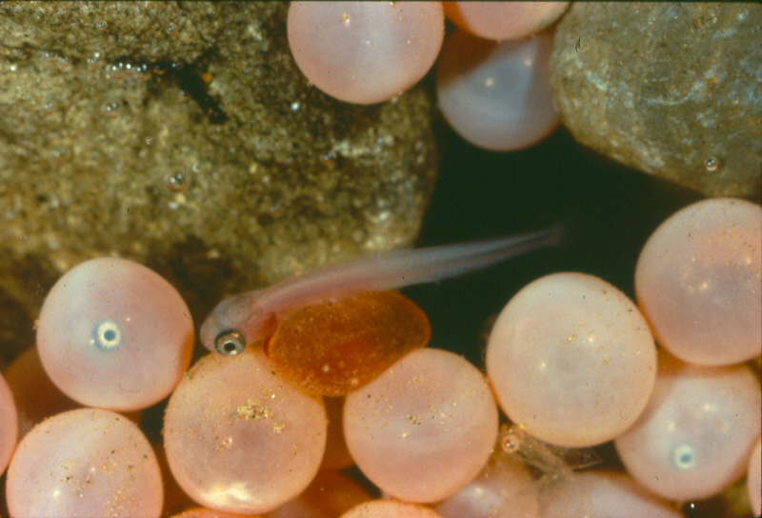
Questions?
Notes:
Eggs and Fry
Females can have 2,500-6,000 eggs; larger/older females tend to have more and larger eggs, which translates into higher reproductive success
Only 2-8% of fish live through the fry stage to become smolts
Newly hatched fish are called “alevins” and remain in the gravel for 3-7 weeks.
Alevins feed from the same yolk sack that sustained them in the egg. Once the yolk sack is absorbed, the fish have to emerge from the gravel to feed. This is when they become “fry”.

